Slide 1
Document management
System
Adviser
Mr.Apinetr Unakul
Chavalit Jintamalit 43010090
Natthakan Worakitpoonpol 43010126
Embedded System Laboratory, KMITL 2003

Slide 2
Section
1. Introduction
2. Design
3. Summary
Embedded System Laboratory, KMITL 2003

Slide 3
Agenda
1. Introduction
  Organization in the world
  Problems without DMS
  Benefit
  DMS & WFM
  The Workflow Management Coalition Specification
  Process definition Model
  The Workflow model
  Standard of Workflow
  Products in the world
  Objective
  Scope
Embedded System Laboratory, KMITL 2003

Slide 4
Organization in the world
Every organizations always have goals
Every organizations always have work process to achieve goals
Every work process always use information from document
Embedded System Laboratory, KMITL 2003

Slide 5

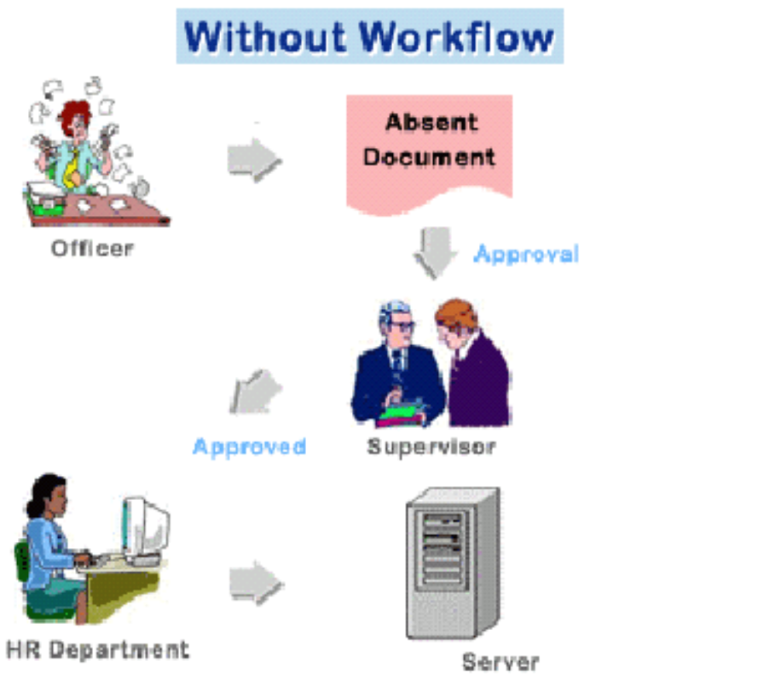
Problems without DMS
Duplicated documents
Lost documents
Hard to manage documents
Too much increasing number of documents
Embedded System Laboratory, KMITL 2003

Slide 6
Benefits
Reducing costs
Saving time
Easier access to documents
Improving corporate knowledge
increase productivity, support teamwork
Embedded System Laboratory, KMITL 2003

Slide 7
DMS & WFM
DMS (Document Management System)
WFM (Workflow Management)
Embedded System Laboratory, KMITL 2003

Slide 8
Example Workflow
A
B
C
E
D
F
Embedded System Laboratory, KMITL 2003

Slide 9
The Workflow Management Coalition Specification
All WFM systems should provide support in three functional areas:
  the Build-time functions
  the Run-time control functions
  the Run-time interactions
Embedded System Laboratory, KMITL 2003

Slide 10
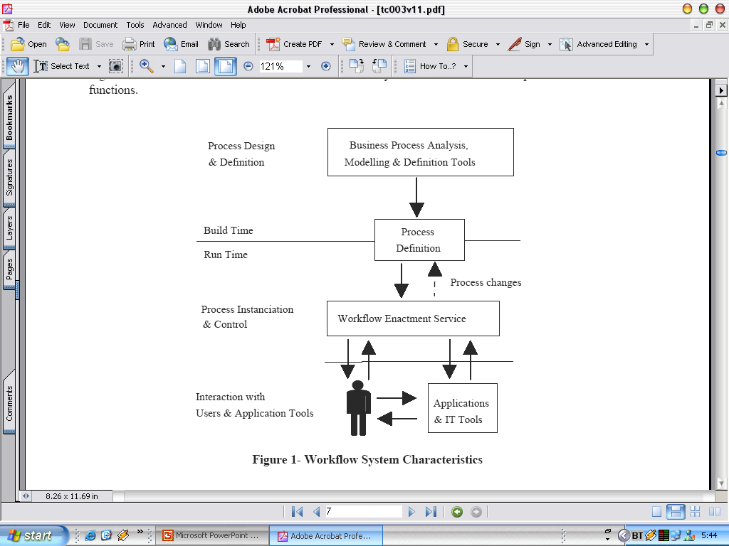
The Workflow Management Coalition Specification
Workflow System Characteristics
Embedded System Laboratory, KMITL 2003

Slide 11
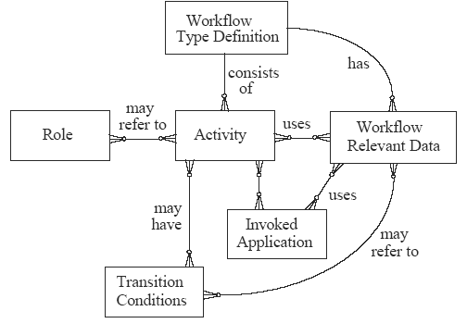
Process definition Model
Embedded System Laboratory, KMITL 2003

Slide 12
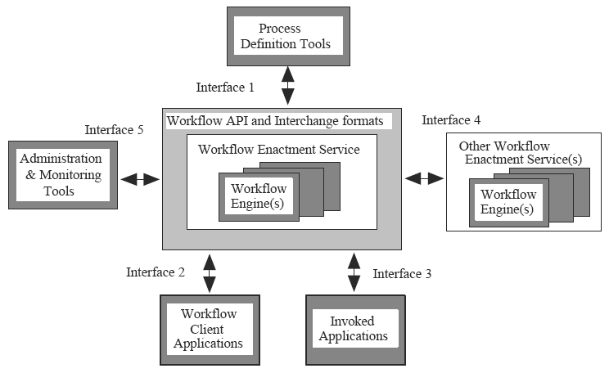
The Workflow model

Slide 13
WMS License Product
Lotus note 5.0.9
Feature
- Event Editor -> Create and Edit Events (Activity)
- Workflow Editor -> Create and Edit Workflows
- Calendar Editor -> Assign work to Calendar
- Mail Server (notify)
- To do list -> task list in calendar
Embedded System Laboratory, KMITL 2003

Slide 14
WMS Open source Product
Metis (http://www-serl.cs.colorado.edu/metis/index.html)
Feature
  - Event Editor -> Create and Edit Events (Activity)
  - Workflow Editor -> Create and Edit Workflows
  - Action Editor ->Create actions for events in Workflows
  - Workflow Monitor -> Monitor Workflows
  - Registry -> Create and Edit Users, Groups and Roles
  - Workflow Viewer -> View Completed Workflows
Embedded System Laboratory, KMITL 2003

Slide 15
Objective
เพื่อศึกษาระบบการไหลของงาน
เพื่อพัฒนาโปรแกรมที่ใช้ในระบบการจัดการเอกสารโดยผ่านทางเว็บเพ็จ
เพื่อศึกษาการเขียนโปรแกรมประยุกต์บนอินเตอรเนต (Web Application) โดยใช้ภาษาประเภทที่ประมวลผลบนฝั่งเซิร์ฟเวอร์ (Server Side Script)
เพื่อศึกษาการออกแบบและใช้งานระบบฐานข้อมูล
เพื่อนำหลักการต่างๆ ที่ไดเรียนมา มาประยุกต์ในการออกแบบและสร้างโปรแกรมประยุกต์ที่ใช้งานได้จริง
Embedded System Laboratory, KMITL 2003

Slide 16
Scope
1. Develop DMS (a part of workflow) for Business Process
DMS
(workflow)
Business Process
Embedded System Laboratory, KMITL 2003

Slide 17
Scope
2. Develop Workflow Definition Tool for Admin
Workflow
Engine
Workflow
Definition Tool
Admin
Embedded System Laboratory, KMITL 2003

Slide 18
Scope (cont)
3. Develop Administration and monitoring tool
Workflow
Engine
monitoring tool
Admin
Embedded System Laboratory, KMITL 2003

Slide 19

Scope (cont)
4. Develop Web Application for User
Workflow
Engine
Web
Application
Users
Embedded System Laboratory, KMITL 2003

Slide 20
Scope (cont)
5. Implement Web application with JSP
Work flow
Engine
Web Browser
Web (JSP)
Embedded System Laboratory, KMITL 2003

Slide 21
Agenda
2. Design
  Analyze Phase
    Get requirement
    Use case Diagram
  Design Phase
    Class Diagram
    Database Design
    User Interfaces
    How to operate DMS?
Embedded System Laboratory, KMITL 2003

Slide 22
Get Requirement
Admin
  Create/Edit/Delete User
  Create/Edit/Delete Group
  Create/Edit/Delete Role
  Create/Edit/Delete Workflow and document type
  Monitor
    Performance monitor
    Performance report
Embedded System Laboratory, KMITL 2003

Slide 23
Get Requirement (cont)
User
  Create/Submit/Reject/Turn back Document
  Take work from Worklist
  Edit user profile
  Track work
Embedded System Laboratory, KMITL 2003

Slide 24
Get Requirement (cont)
Tool of Development
  JSP Editor
    Implement Web with JSP
  Apache Tomcat 4.1
    Run The System
  SQL Server 2000
    Relational DBMS of The System
  Rational Rose
    Design UML of The System
Embedded System Laboratory, KMITL 2003

Slide 25
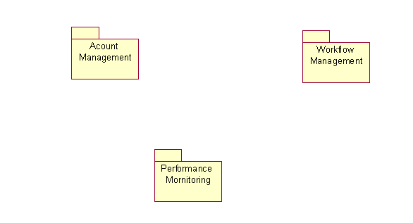
Use case diagram
Embedded System Laboratory, KMITL 2003

Slide 26
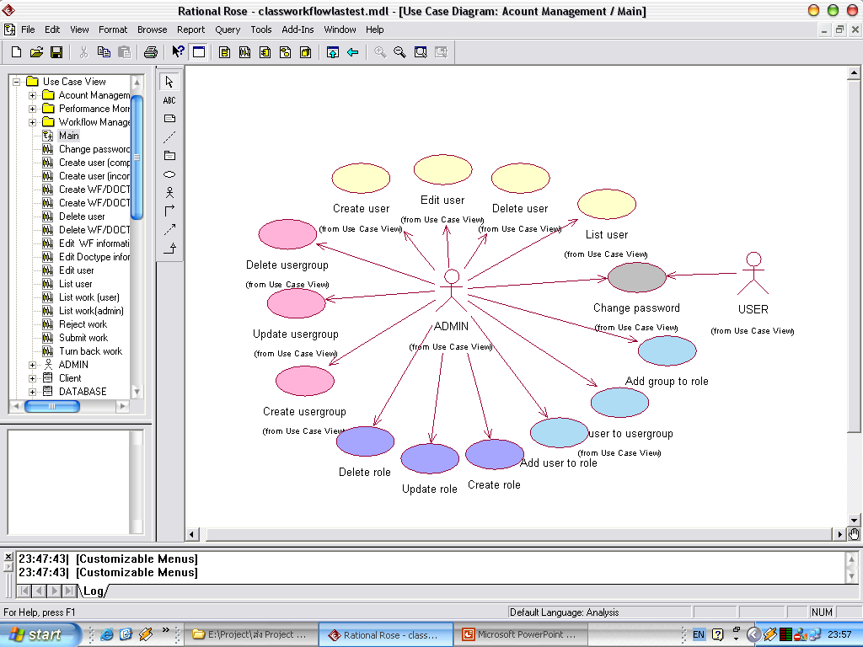
Use case diagram (cont)
Account Management
Embedded System Laboratory, KMITL 2003

Slide 27
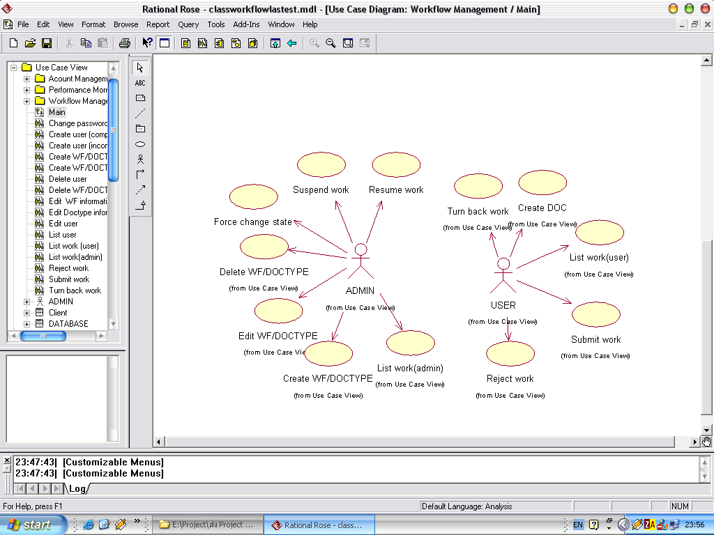
Use case diagram (cont)
Workflow Management

Slide 28
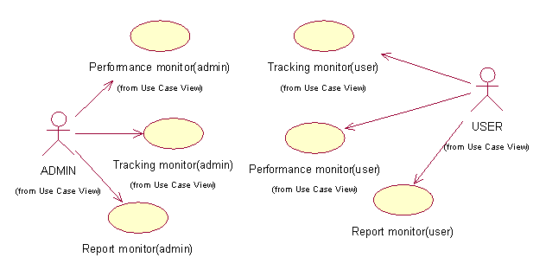
Use case diagram (cont)
Performance Monitoring
Embedded System Laboratory, KMITL 2003

Slide 29
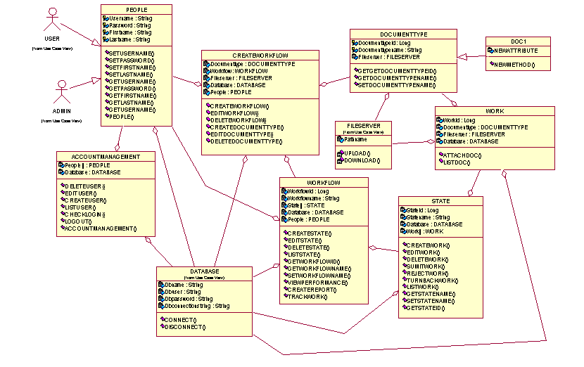
Class diagram
Embedded System Laboratory, KMITL 2003

Slide 30
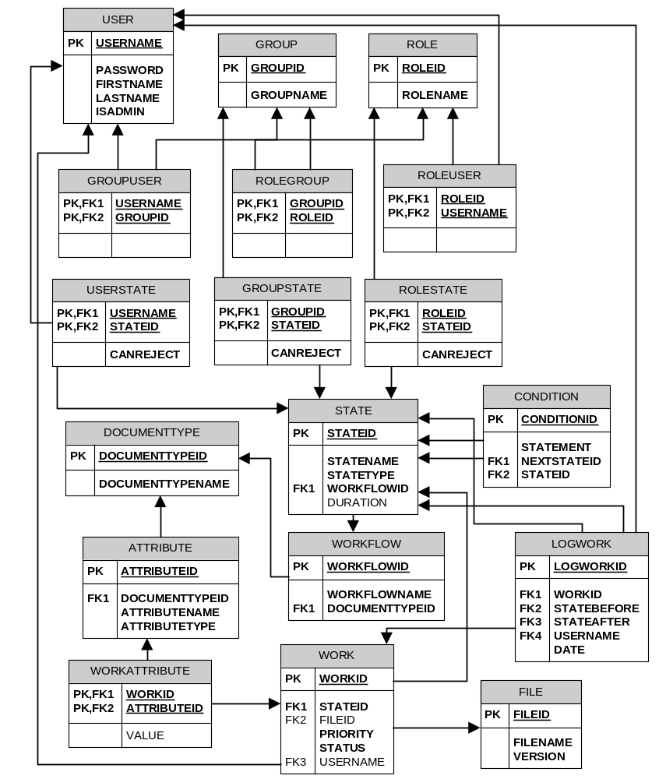
Database Design

Slide 31
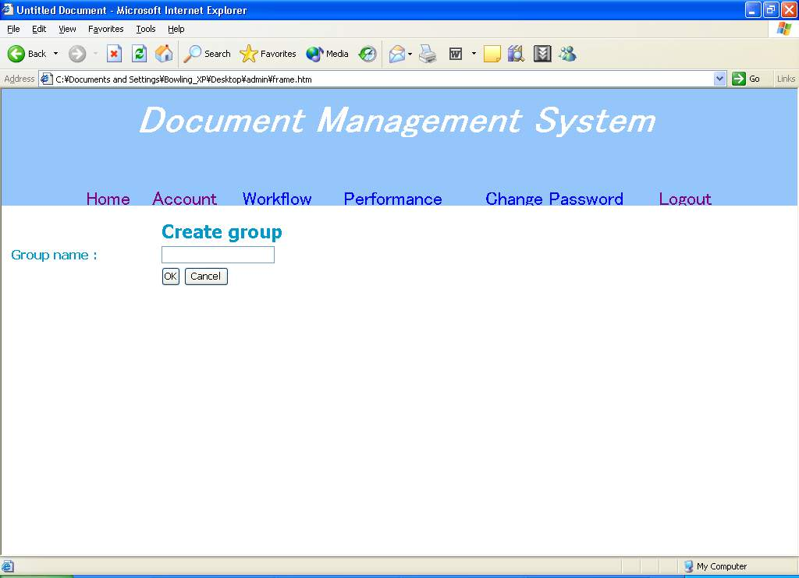
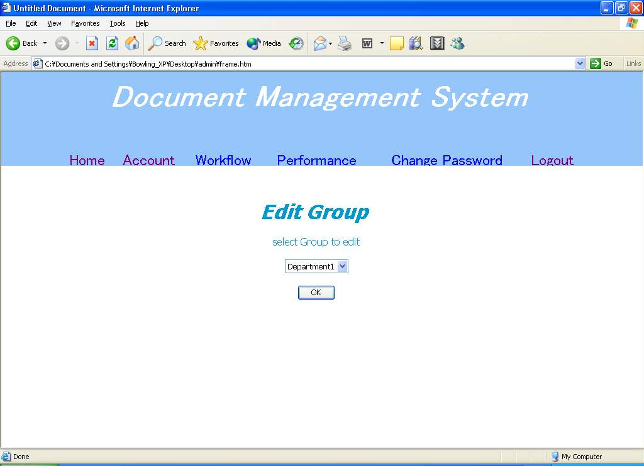

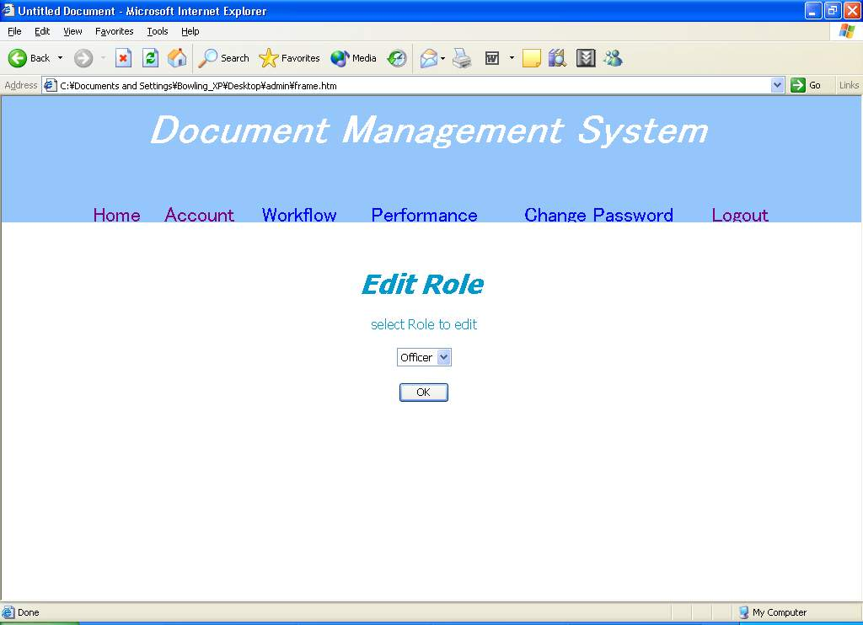
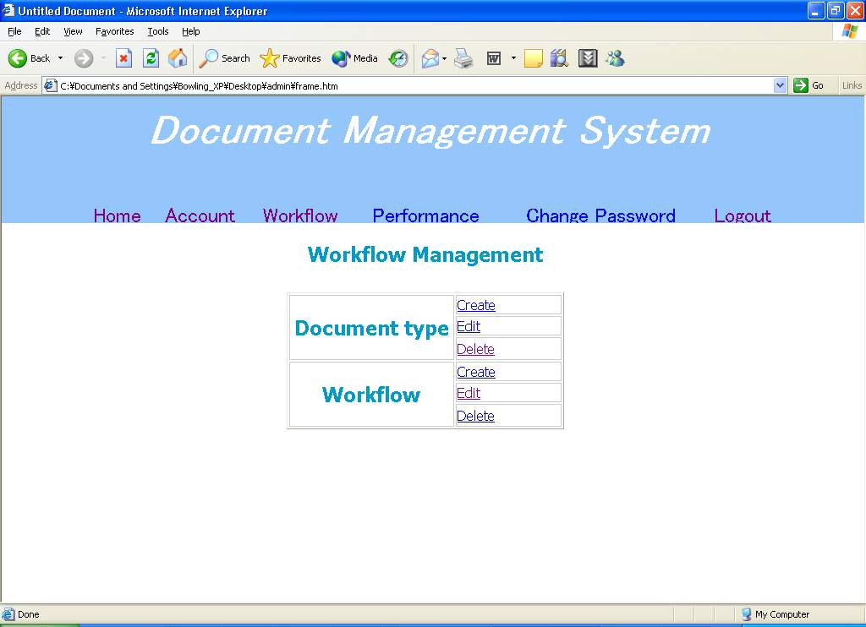
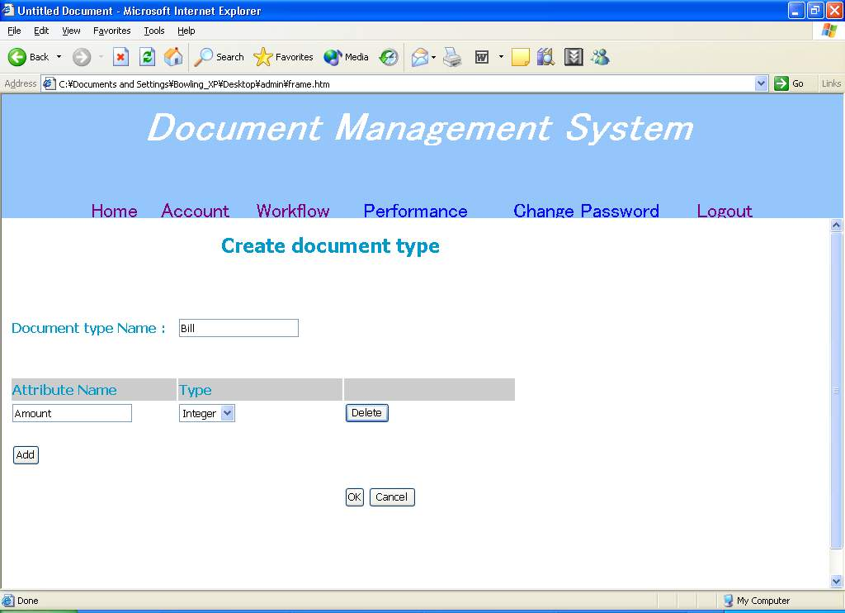
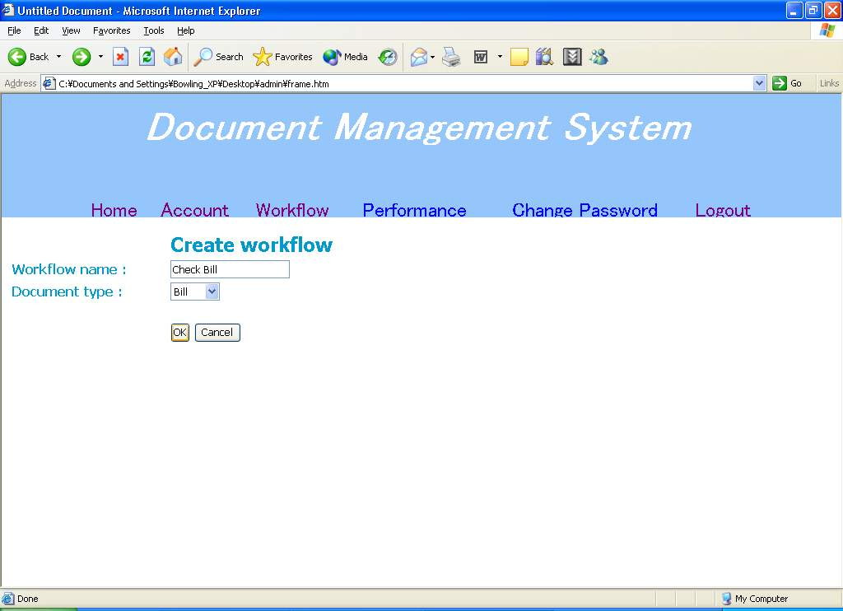
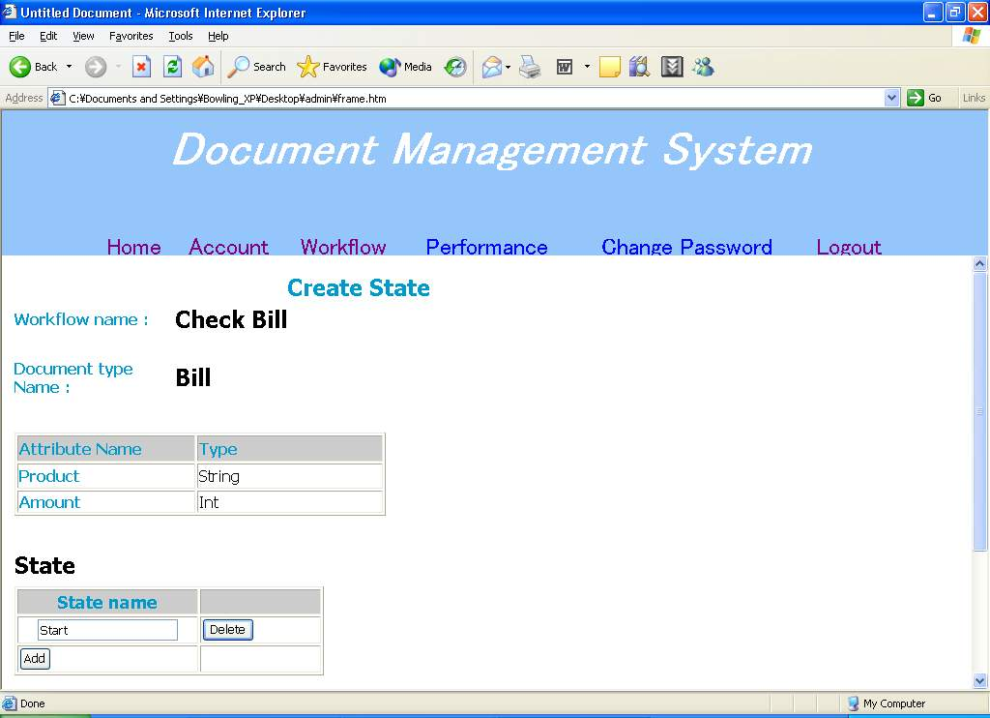
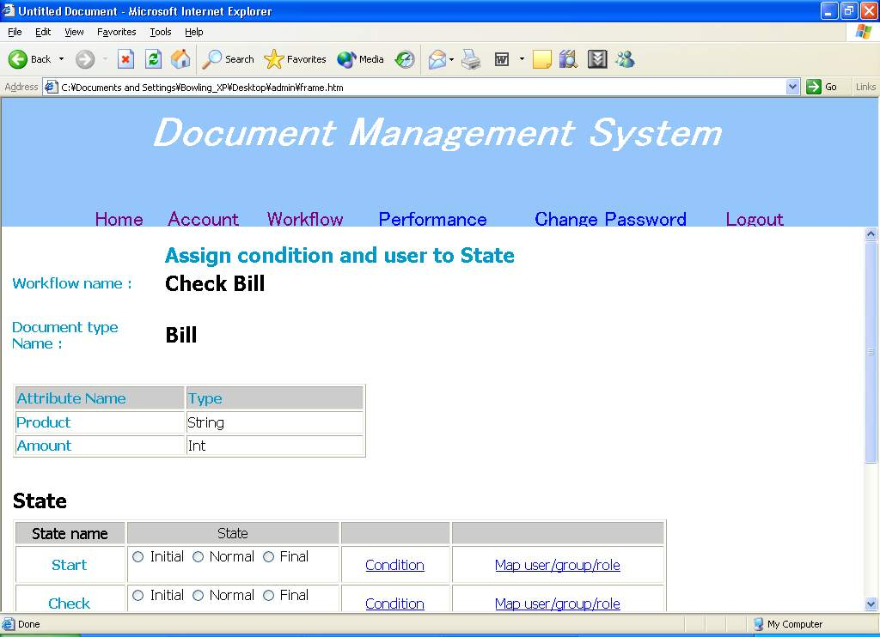
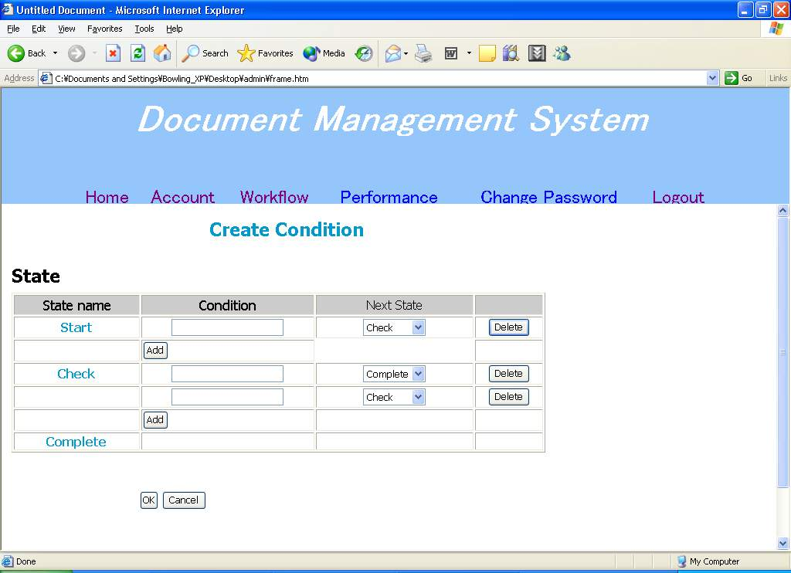
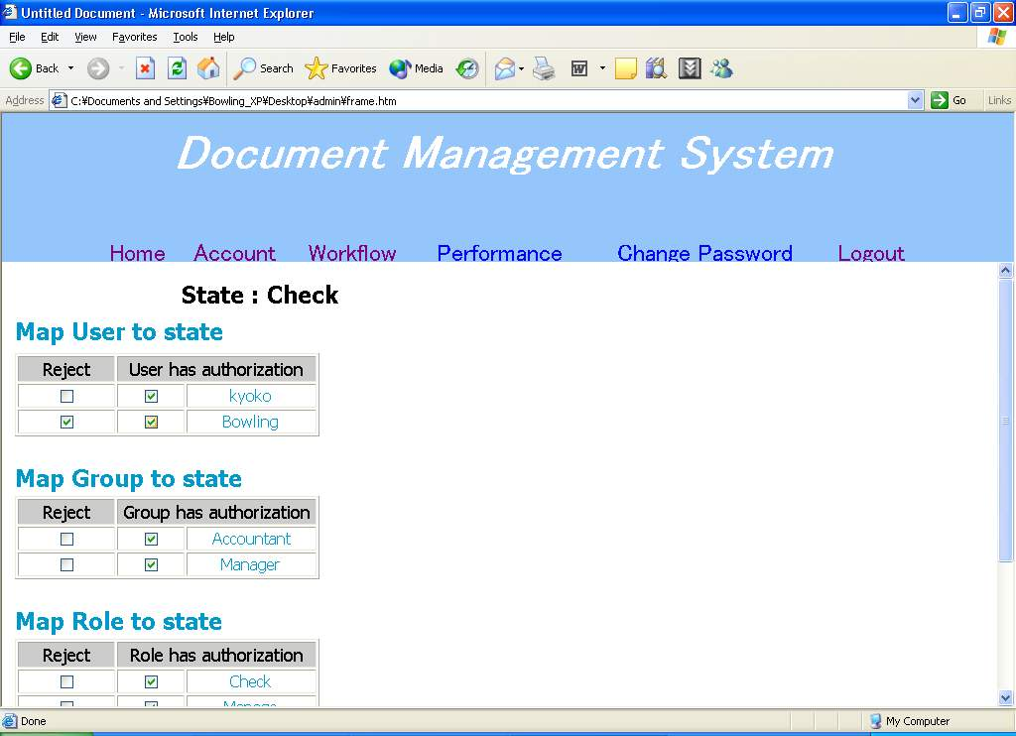
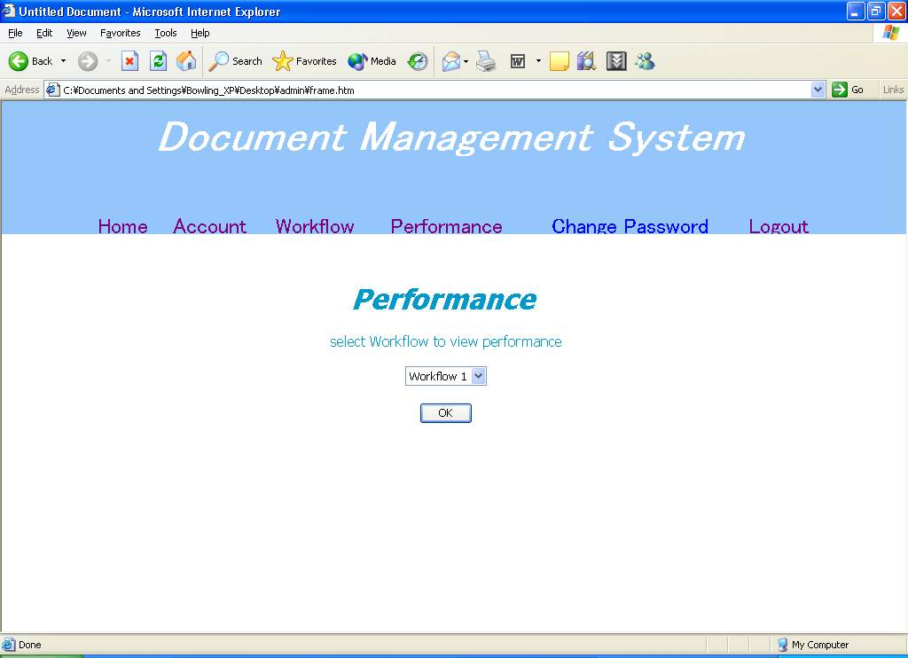
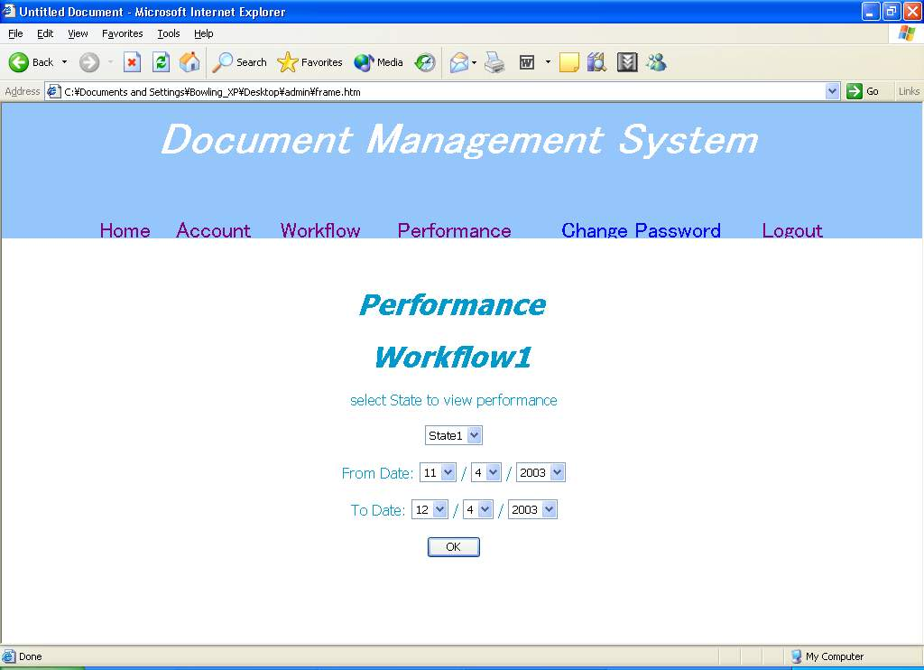
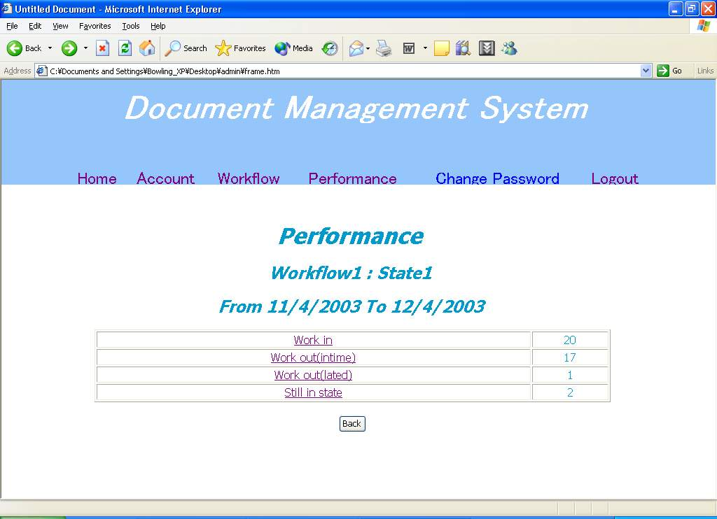
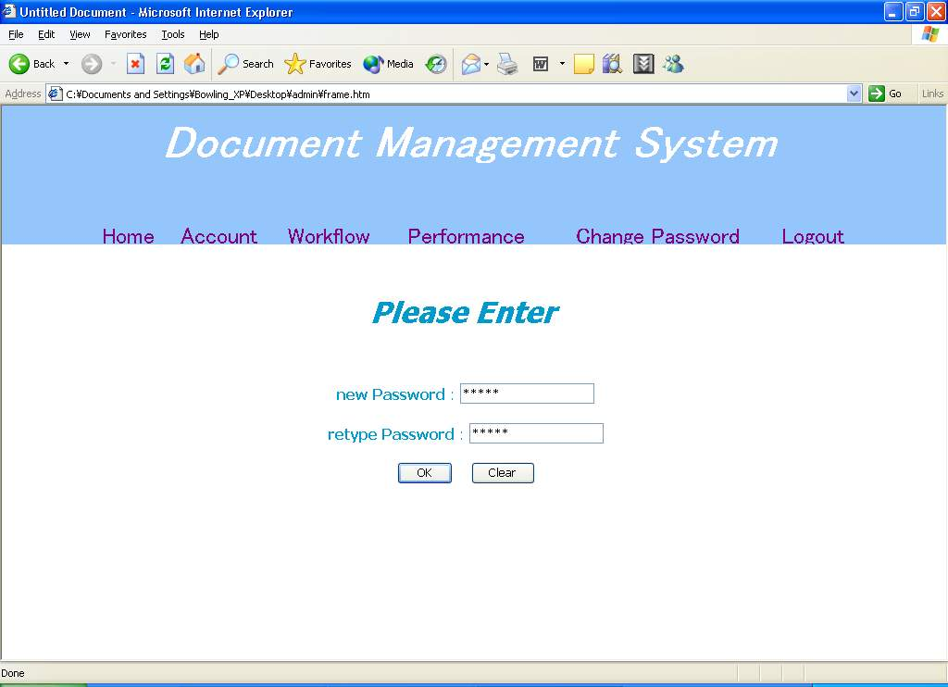
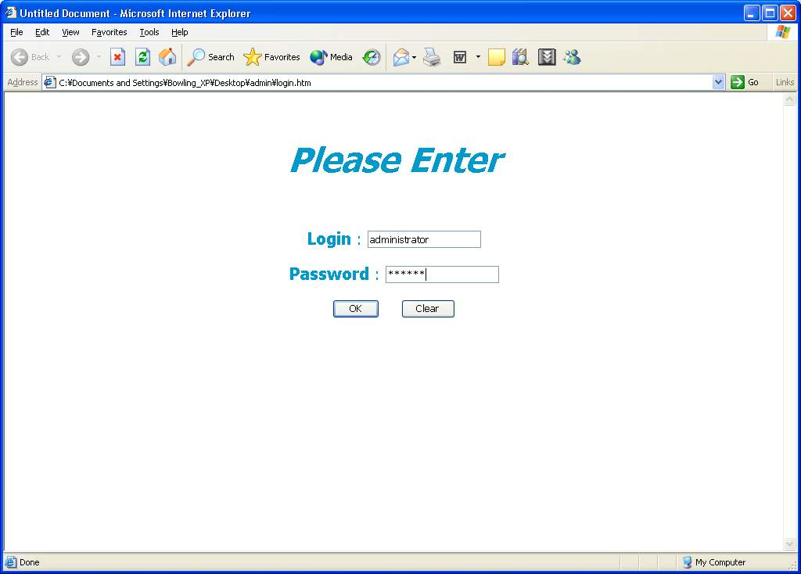
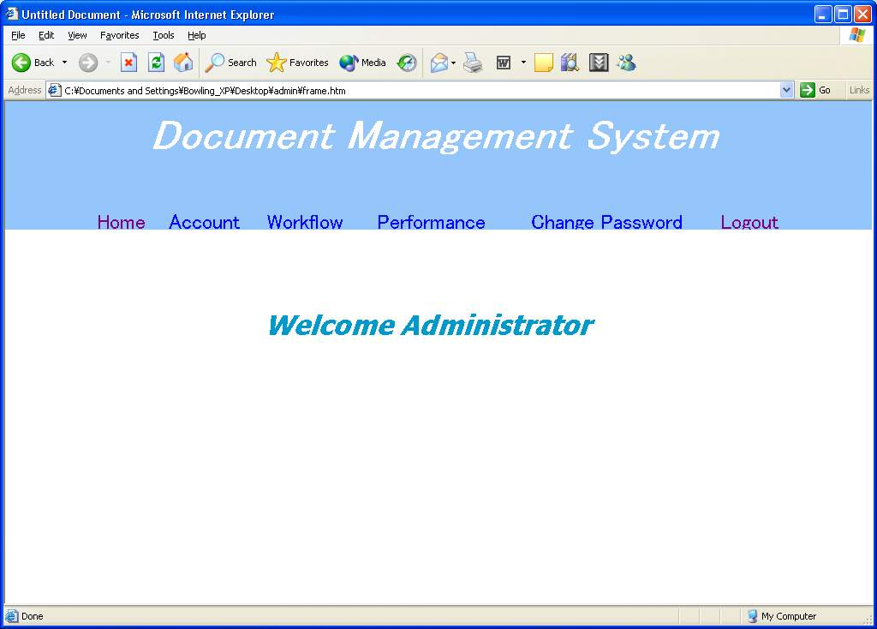
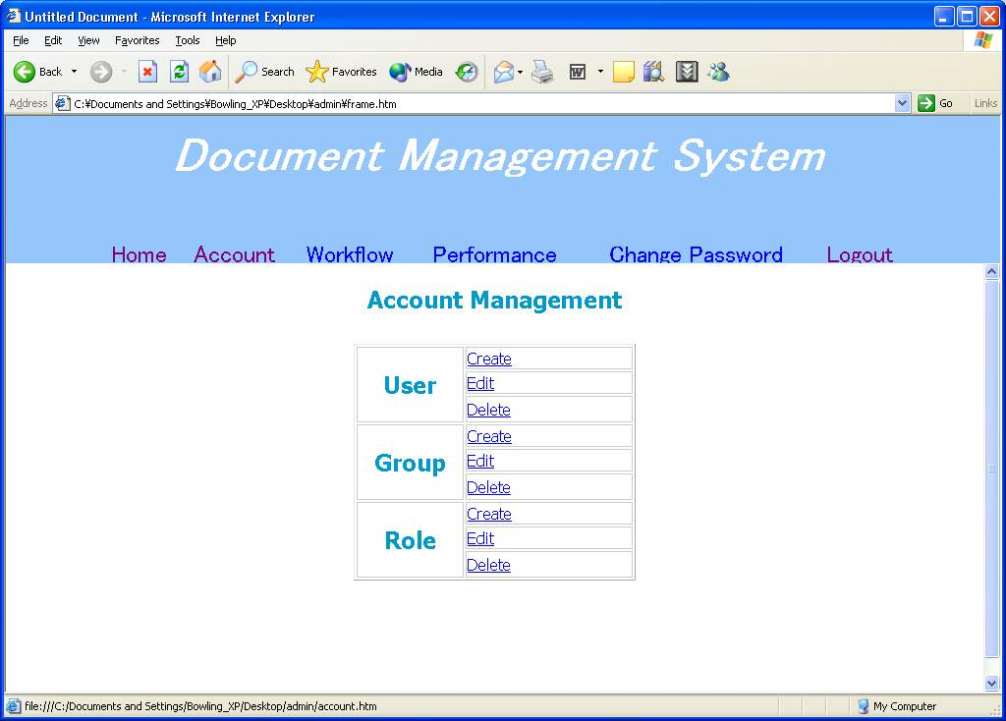
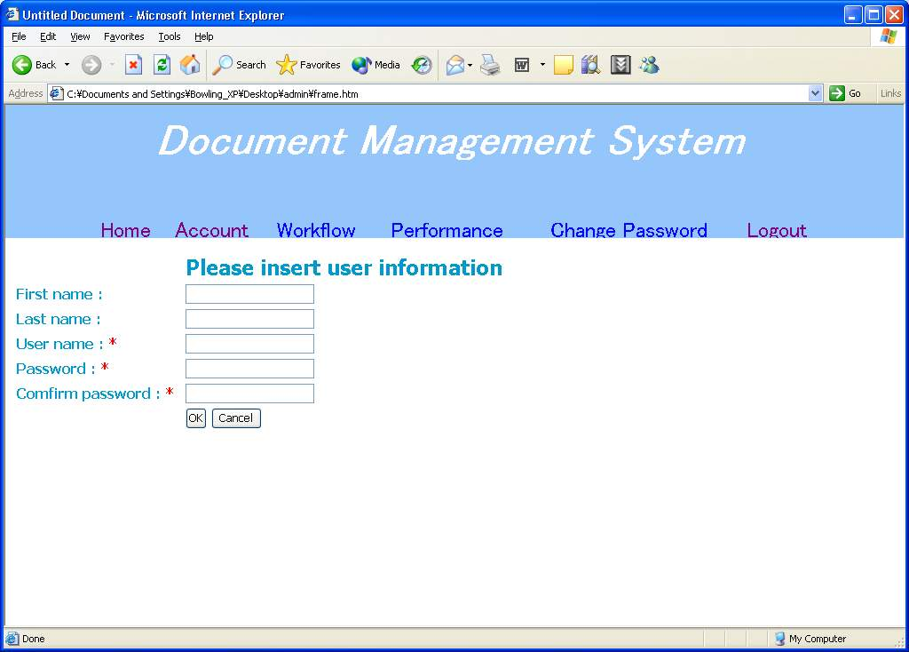
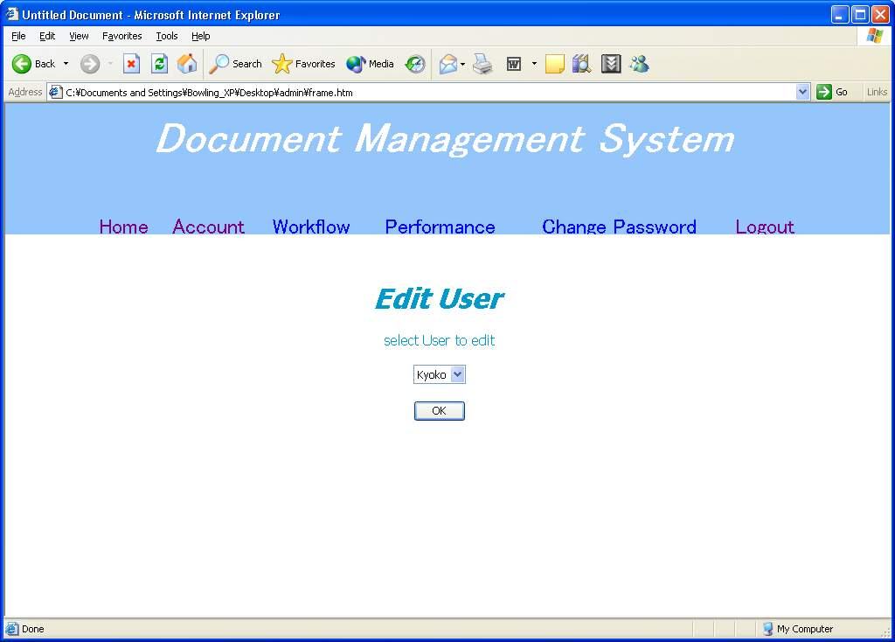
User Interface (Admin)

Slide 32
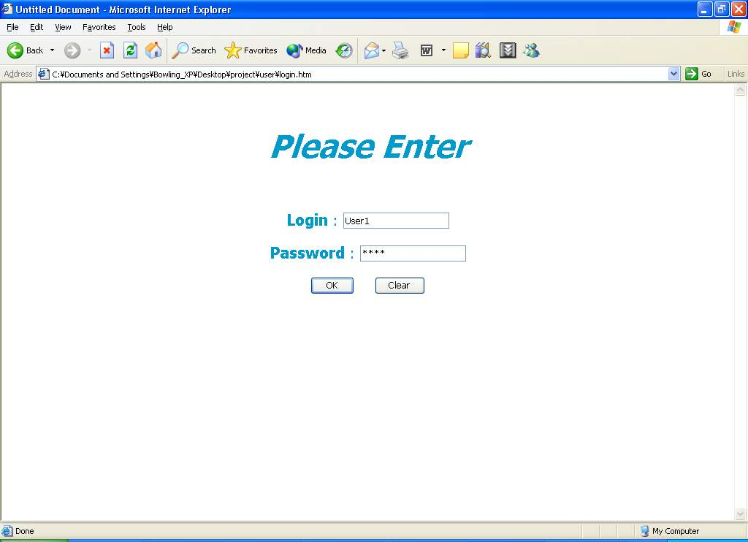
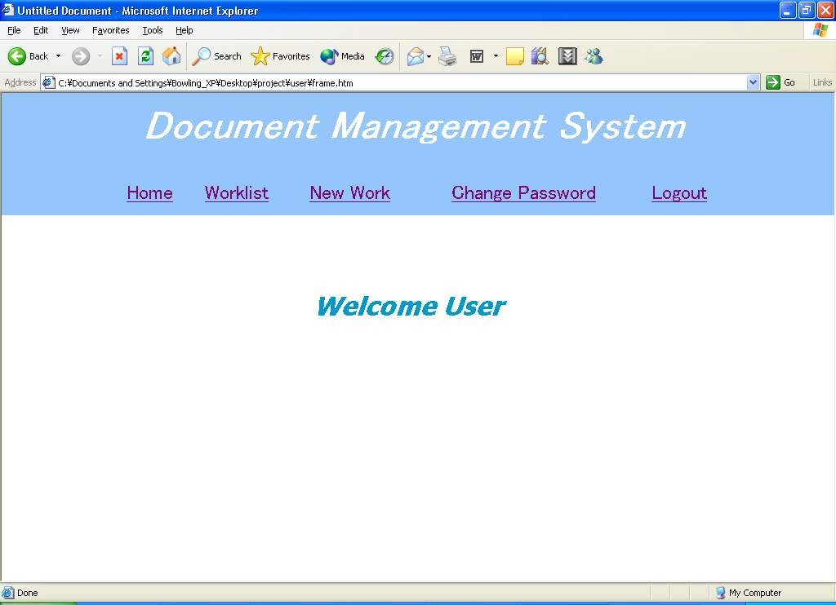
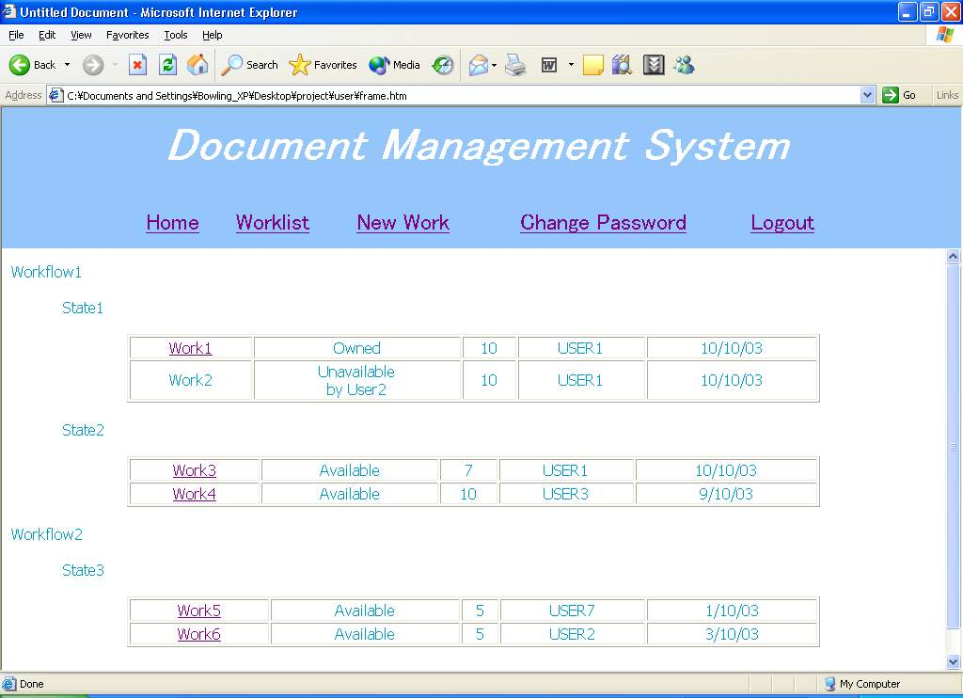
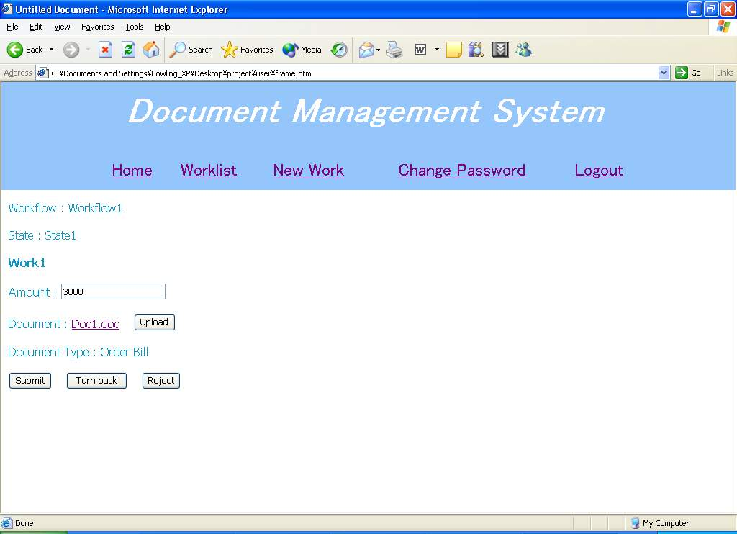
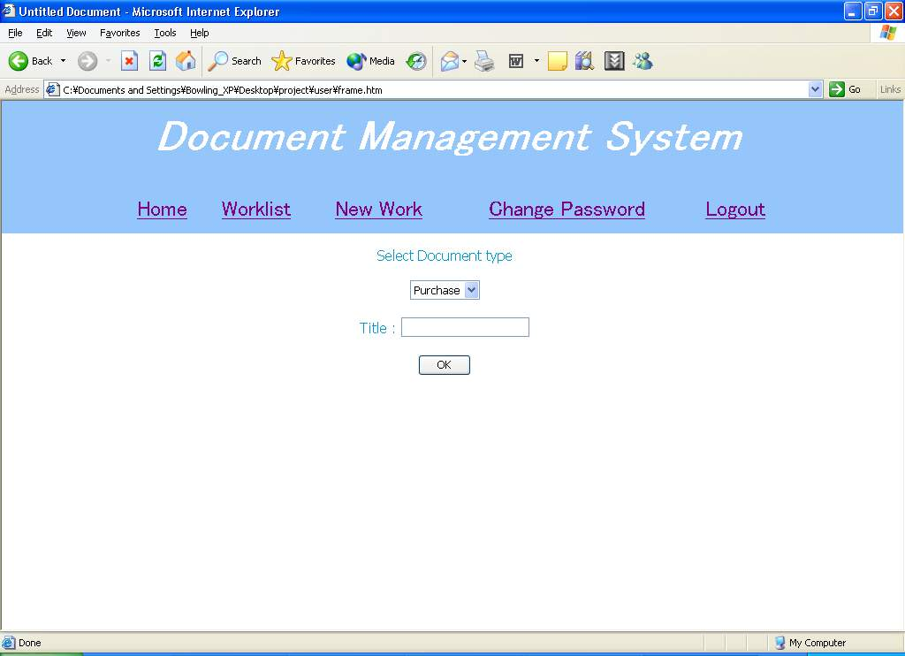
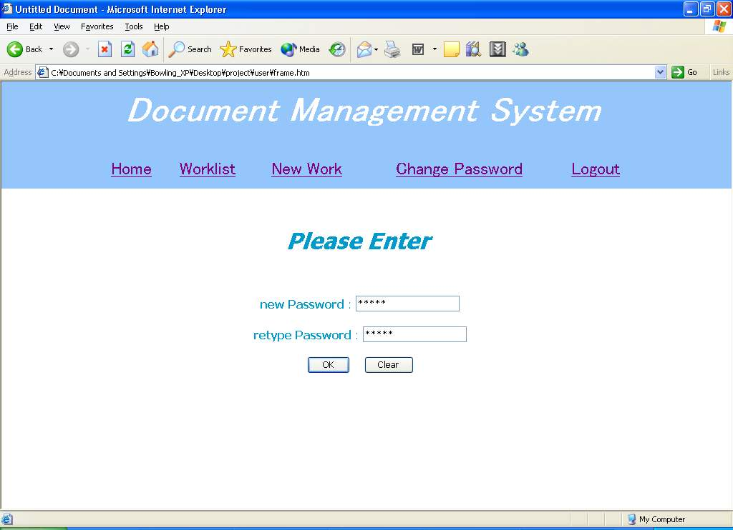
User Interface (User)

Slide 33
Agenda
3. Summary
  Timeline
  Progress
  Plan for Next term
Embedded System Laboratory, KMITL 2003

Slide 34
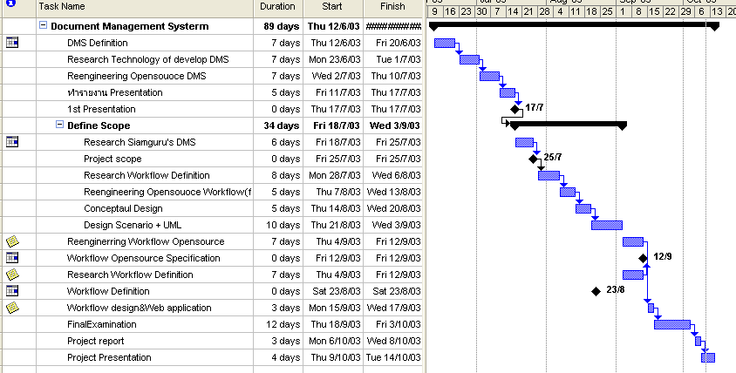
Timeline

Slide 35
Progress
Use case
Sequential diagram
Class diagram
ER Diagram
User Interface
Embedded System Laboratory, KMITL 2003

Slide 36
Plan for next term
Learn Technology
Rapid prototype
Test prototype & redesign
Implement Document Management System
Embedded System Laboratory, KMITL 2003

Slide 37

Question
Embedded System Laboratory, KMITL 2003

Slide 38
Question
Embedded System Laboratory, KMITL 2003

Slide 39
Workflow Reference Model
  The core component is workflow engine
  The interfaces within the workflow architecture.
  1. Process Definition Tools
  2. Workflow Client Applications
  3. Invoked Applications
  4. Other Workflow Enactment Service(s) //out of scope
  5. Administration & Monitoring Tools
Embedded System Laboratory, KMITL 2003

Slide 40
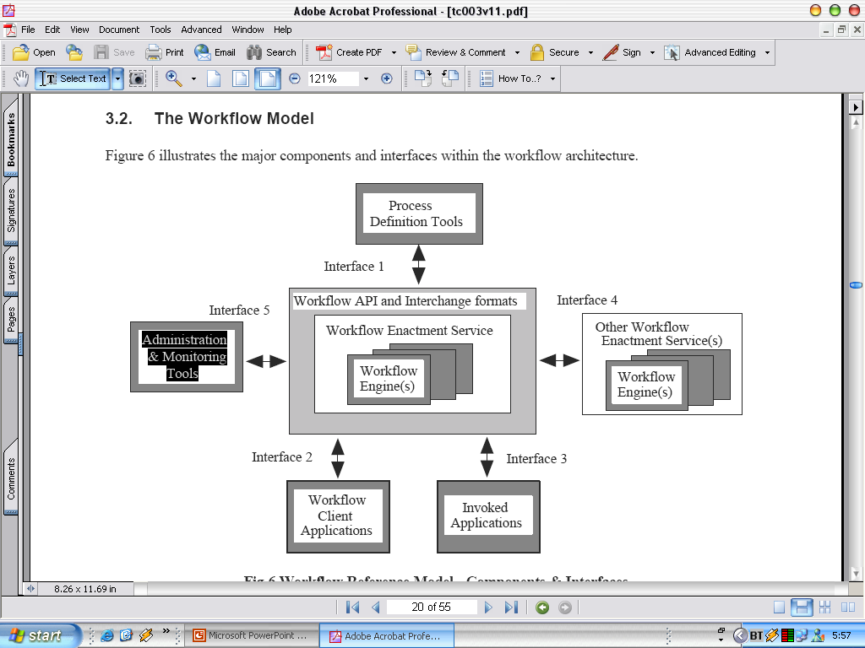
Workflow Reference Model

Slide 41
Workflow Reference Model
1. Process Definition Tools
    Workflow Type Definition
    · Workflow process name
    · Version number
    · Process start and termination conditions
    · Security, audit or other control data
    Activity
    · Activity name
    · Activity type (subflow, atomic flow, etc)
    · Pre- and post- activity conditions
    · Other scheduling constraints
    Transition Conditions
    · Flow or Execution conditions
Embedded System Laboratory, KMITL 2003

Slide 42
Workflow Reference Model
1. Process Definition Tools
Workflow relevant data
    · Data name and path
    · Data types
    Role
    · Name and organizational entity
    Invoked Application
    · Generic type or name
    · Execution parameters
    · Location or access path
Embedded System Laboratory, KMITL 2003

Slide 43
Workflow Reference Model
  2. Workflow Client Application
    Session Establishment
    · connection / disconnection of sessions between participating systems
    Workflow Definition Operations
    · retrieval / query functions (with optional selection criteria) on workflow process definition names or attributes
Embedded System Laboratory, KMITL 2003

Slide 44
Workflow Reference Model
  2. Workflow Client Application
    Process Control Functions
    · creation / starting / termination of an individual process instance
    · suspension / resumption of an individual process instance
    · forcing a state change within an individual process instance or activity instance
    · assignment or query of an attribute (eg priority) of a process or activity instance
Embedded System Laboratory, KMITL 2003

Slide 45
Workflow Reference Model
  2. Workflow Client Application
    Process Status Functions
    · Opening / closing a process or activity instances query, setting optional filter criteria
    · Fetching details of process instances or activity instances, filtered as specified
    · Fetching details of a specific (individual) process or activity instance
Embedded System Laboratory, KMITL 2003

Slide 46
Workflow Reference Model
  2. Workflow Client Application
    Worklist/Workitem Handling Functions
    · Opening / closing a worklist query, setting optional filter criteria
    · Fetching worklist items, filtered as specified
    · Notification of selection / reassignment / completion of a (specific) workitem
    · Assignment or query of a workitem attribute
Embedded System Laboratory, KMITL 2003

Slide 47
Workflow Reference Model
  2. Workflow Client Application
    Process Supervisory Func
    · changing the operational status of a workflow process definition and/or its extant process instances
    · changing the state of all process or activity instances of a specified type
    · assigning attribute(s) to all process or activity instances of a specified type
    · termination of all process instances
    Data Handling Functions
    · retrieval / return of workflow relevant or application data
Embedded System Laboratory, KMITL 2003

Slide 48
Workflow Reference Model
  3. Invoked Application
    Session Establishment
    • connection / disconnection of application (or application agent) session
    Data Handling Functions
    • Give workflow relevant data
    • Give application data or data address
Embedded System Laboratory, KMITL 2003

Slide 49
Workflow Reference Model
  3. Invoked Application
    Activity Management Functions
    (workflow engine to application)
    · Start activity (workflow engine to application)
    · Suspend/Resume/Abort activity (where an asynchronous application interface is available)
    (application to workflow engine)
    · Activity complete notification
    · Signal event (eg synchronisation)
    · Query activity attributes
Embedded System Laboratory, KMITL 2003

Slide 50
Workflow Reference Model
  5. Administration & Monitoring Tools
  User Management operations
  · establishment / deletion / suspension / amendment of privileges of users or workgroups
  Role Management operations
  · define / delete / amend role:participant relationships
  · set or unset role attributes
  Audit Management operations
  · query / print / start new / delete audit trail or event log, etc
Embedded System Laboratory, KMITL 2003

Slide 51
Workflow Reference Model
  5. Administration & Monitoring Tools
  Process Supervisory Functions
  · changing the operational status of a workflow process definition and/or its extant process instances
  · enabling or disabling particular versions of a process definition
  · changing the state of all process or activity instances of a specified type
  · assigning attribute(s) to all process or activity instances of a specified type
  · termination of all process instances
Embedded System Laboratory, KMITL 2003

Slide 52
Workflow Reference Model
  5. Administration & Monitoring Tools
  Resource Control operations
  · set / unset / modify process or activity concurrency levels
  · interrogate resource control data (counts, thresholds, usage parameters, etc)
  Process Status Functions
  · Opening / closing a process or activity instances query, setting optional filter criteria
  · Fetching details of process instances or activity instances, filtered as specified
  · Fetching details of a specific (individual) process or activity instance
Embedded System Laboratory, KMITL 2003

